Slide 1


Park Ease: IOT- Based Smart Parking Management System
An IoT-enabled framework solution addressing modern urban static-resource allocation crises.
PRESENTED BY
PROJECT GUIDE
Mithulesh N (25MX328)
Dr. A. Sankar
Dinesh Kumar S (25MX312)

Slide 2

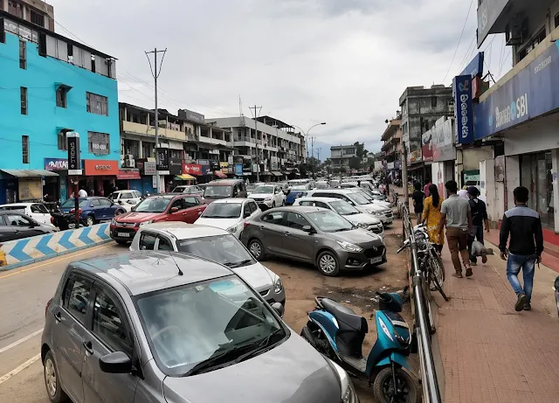

Problem Statement: The Problem
The Infrastructure Bottleneck
Operational Failures
Rapid growth in vehicle usage has outpaced static parking structures in high-density areas. Traditional methods create critical flow blockages at entry and exit points due to slow processing.
No real-time parking space utilization feeds.
Manual oversight leads to traffic bottlenecks.
Cruising for vacant spaces accounts for significant local urban micro-traffic, leading to high fuel consumption and excessive localized carbon emissions.
Traditional rigid booking fails to balance peak vs. standard hours, leading to vacant reserved slots.
Park Ease • Zeroth Review
Slide 2

Slide 3






Problem Statement: Affected Users
Primary Drivers
Venue Operators
City Administrations
Daily vehicle owners experiencing high delays, unpredictability, and micro-parking search anxiety in critical dense environments.
Commercial hubs, tertiary care hospitals, and universities experiencing manual access processing overheads and system-level inefficiencies.
Smart city infrastructure groups and parking authorities lacking real-time data-driven oversight over local transit parking bottlenecks.
Park Ease • Zeroth Review
Slide 3

Slide 4

Existing System & Limitations
Legacy Methods
Bottlenecks
Traditional architectures are fundamentally passive, depending on staff direction, FCFS physical queuing, and paper check-ins.
Resource Lock-in: No system to forecast space usage or prevent artificial reservations holding empty bays.
High Integration Costs: Inability to interface with existing localized building IoT frameworks.
Failure mode: Staff errors in paper-logs and manual timing calculation often trigger customer friction and slow processing.
Poor Scalability: Scaling manual infrastructure scales operation costs linearly.
Park Ease • Zeroth Review
Slide 4

Slide 5
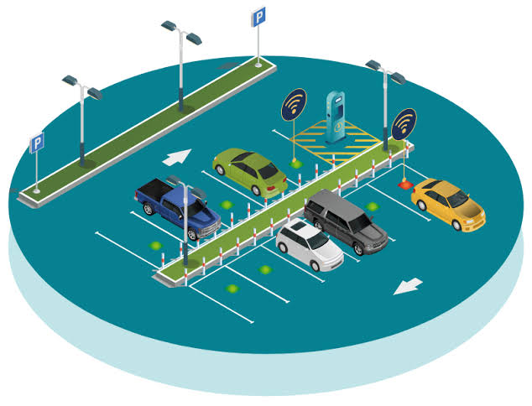

Proposed System Architecture
The IoT Integration Edge
We integrate physical sensor nodes with standard web technologies. Edge nodes leverage ESP32 controllers and HC-SR04 ultrasonic sensors for real-time occupancy updates.
Hybrid Reservation Rule
Maintains FCFS spaces while routing reservations dynamically during free windows. This balance ensures optimal space utilization.
Park Ease • Zeroth Review
Slide 5

Slide 6



Key System Improvements
Automated Workflows
Enhanced Accuracy
Scalable Architecture
Eliminates paper trails and manual timestamps using automated sensor state logging and instant QR code billing generation.
Direct database updates through REST APIs remove human counting errors, double-booking risks, and false empty reports.
Utilizes light Flask APIs and modular database design. This structure scales seamlessly from small garages to multi-level commercial lots.
Park Ease • Zeroth Review
Slide 6

Slide 7





Technology Stack
Frontend
Backend
Database
HTML5, CSS3, JS, Bootstrap 5
Python 3.x, Flask
MySQL relational schema
AI / API
IoT Edge Hardware
Dev Suite
RESTful endpoints (JSON data)
ESP32 module, HC-SR04 sensors
VS Code, Arduino IDE, Workbench
Park Ease • Zeroth Review
Slide 7

Slide 8





Project Timeline
Phase 2
Phase 4
Database Model Design, Entity Schema Architecture, and Client UI Prototyping.
Hardware-Software Integration, Performance Testing, and Documentation.
Phase 1
Phase 3
Problem Identification, Literature Survey, and Requirements Analysis.
Hardware Setup (ESP32 Calibration with Sensors) and Flask Backend API development.
Park Ease • Zeroth Review
Slide 8

Slide 9
Key Project References
Online Library: Recent research papers analyzing ultrasonic sensor latency and space allocation heuristics.
MySQL Server Guide: Optimized patterns for handling real-time indexing in transaction-heavy relational structures.
Espressif Docs: Official data sheets detailing hardware configurations, ESP32 power profiles, and sleep cycles.
Park Ease • Zeroth Review
Slide 9

Slide 10
Thank You
Open for Questions and Discussions
Park Ease • Zeroth Review
Slide 10

